Slide 1

WAY TO ENTERPRISE
AWS
VTI ACADEMY
Author: duy.nguyenngoc1@vti.com.vn

Slide 2
Agenda
Route53 Service
CloudFront Service
Key Management Service
CloudHSM Service
SSM Parameter Store Service
Secrets Manager Service
Assignments
Quiz
Copyright © VTI Academy All Rights Reserved

Slide 3
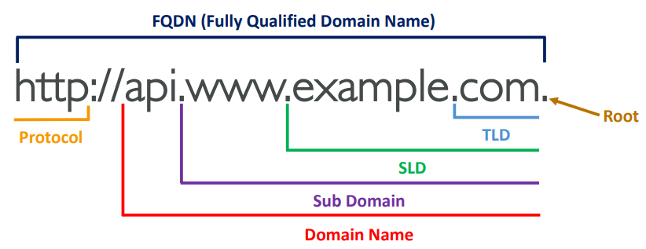
DNS Introduction
Domain Name System (DNS)
Resolve Domain to IP and IP to Domain (Ex: www.google.com 🡺 172.217.18.36)
Domain for human, IP for machine

Slide 4
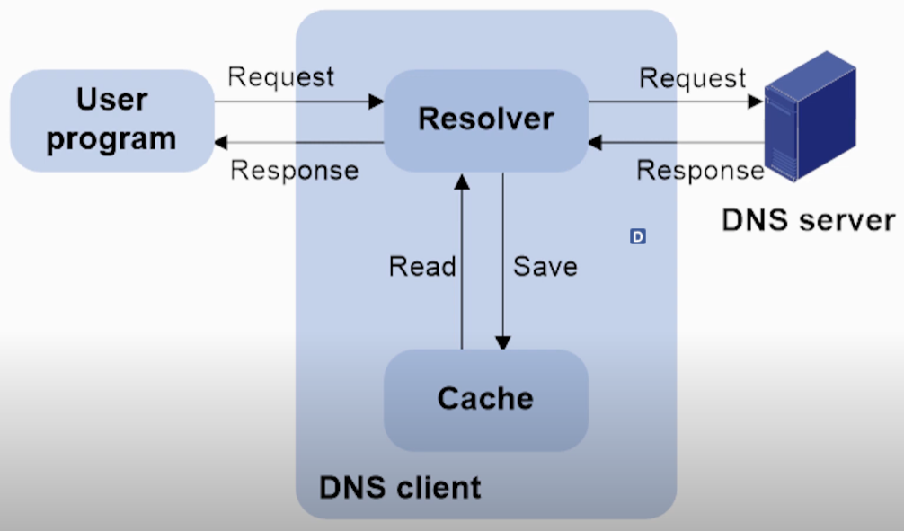
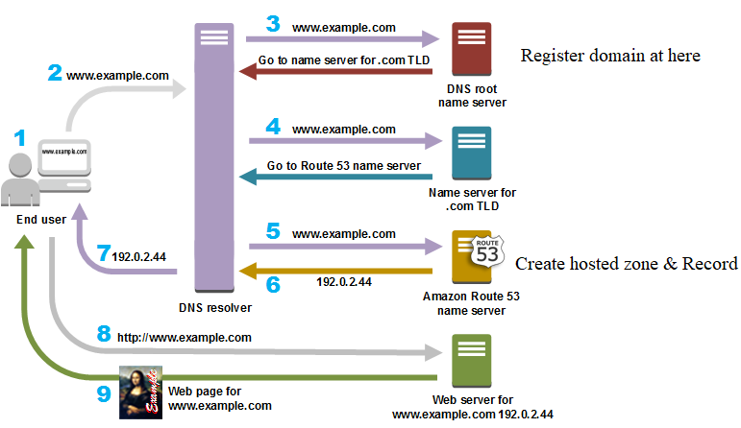
DNS Introduction
Flow
User will send request with domain example.com through browser
Computer will check if there is a cache stored in the computer or not?
If yes, Computer will send back the IP
If not, will make request to Recursive Server
Recursive Server will send request to DNS Resolver
https://www.youtube.com/watch?v=e2xLV7pCOLI

Slide 5
DNS Introduction
Components
Request (with domain) / Response (with IP)
Recursive Server: Is server Mobile network operator (Ex: Google, AWS, Viettel, …)
DNS Resolver (DNS Server): Is a system to search IP based on domain, there are many places in the world
Root name server: Is a list of name servers (.net, .com, .vn, ...)
TLD name server (Top-level domain name server): Contains a list of domains with the same extension (Ex: .com TLD name server, .net TLD name server, …)

Slide 6
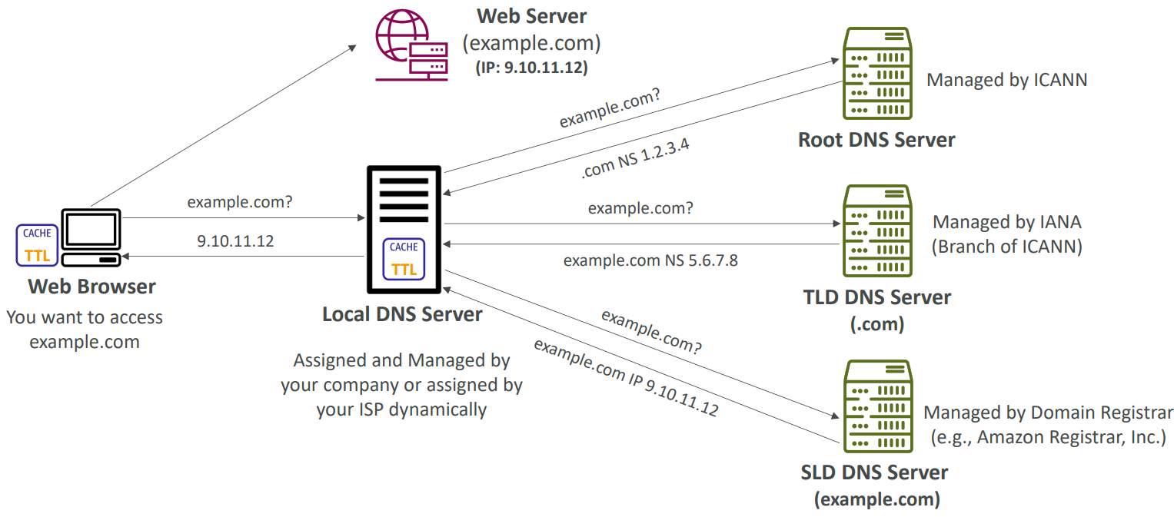
DNS Introduction

Slide 7
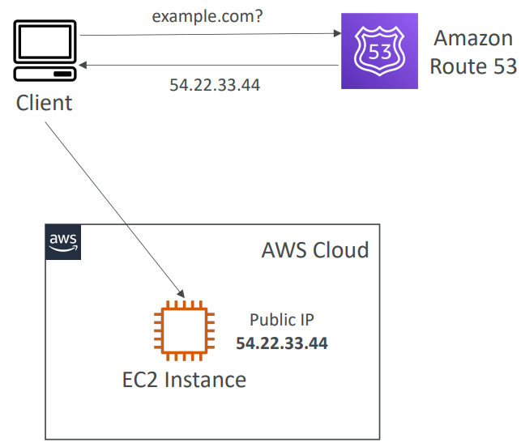
Route53 Service
Is a domain management service on AWS
Can integrate with other services on AWS
Support IP v4 & IP v6
Price: https://aws.amazon.com/route53/pricing
Tutorial: https://docs.aws.amazon.com/Route53/latest/DeveloperGuide/Welcome.html

Slide 8
Route53 Service
Demo
Launch EC2 Instance
Register free Domain
Config Hosted Zone & Record
Update NameServer for Domain
Test

Slide 9
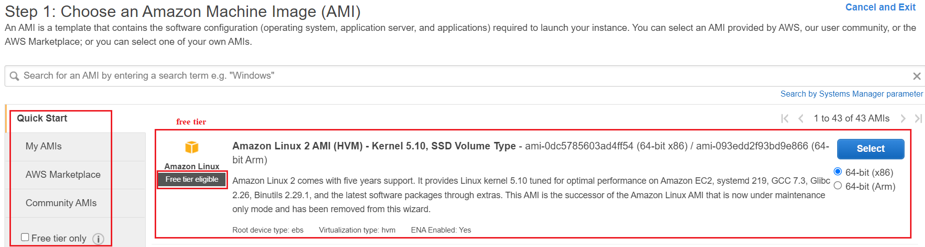
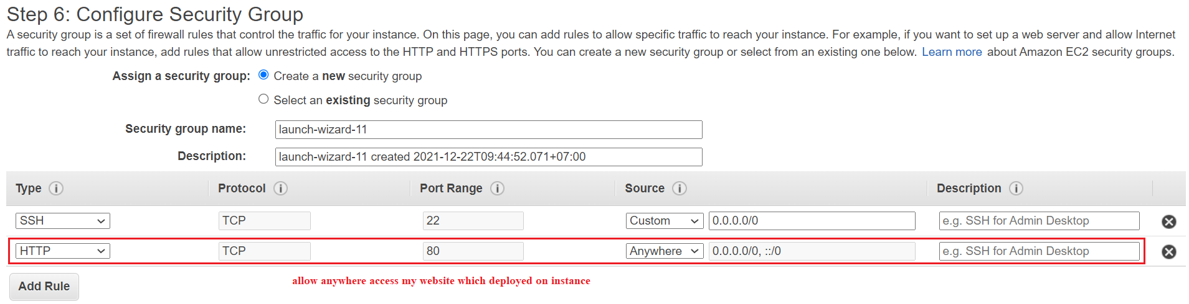
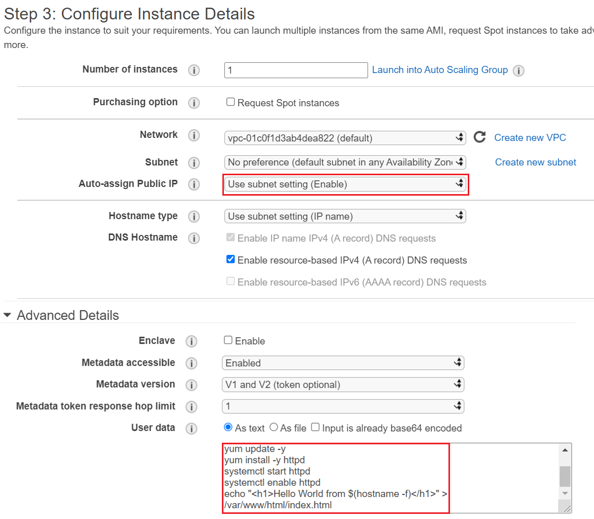
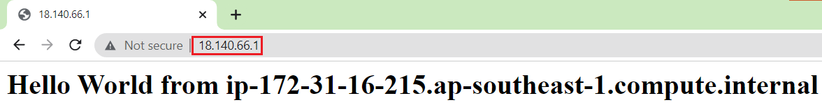
Route53 Service
Launch EC2 Instance

Slide 10
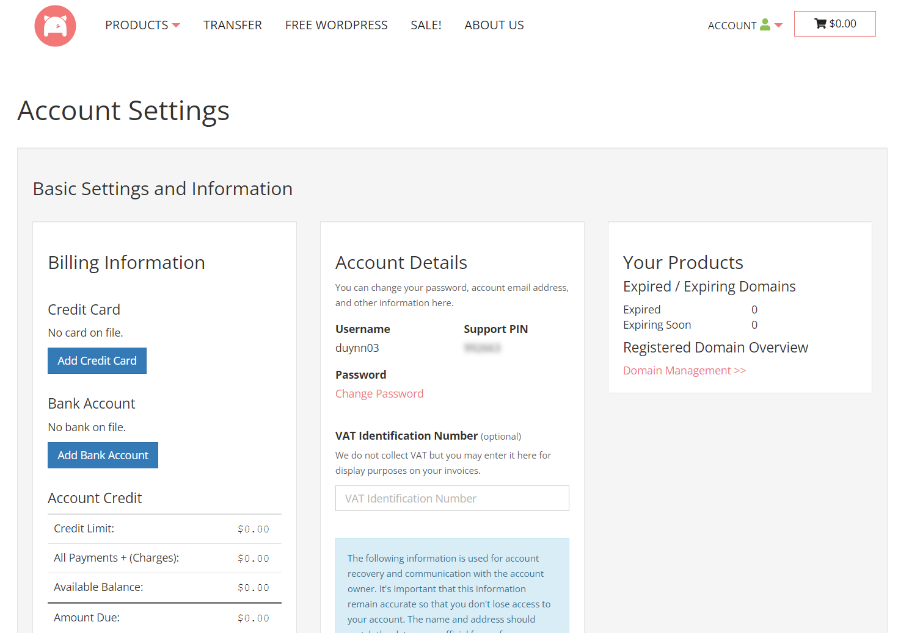
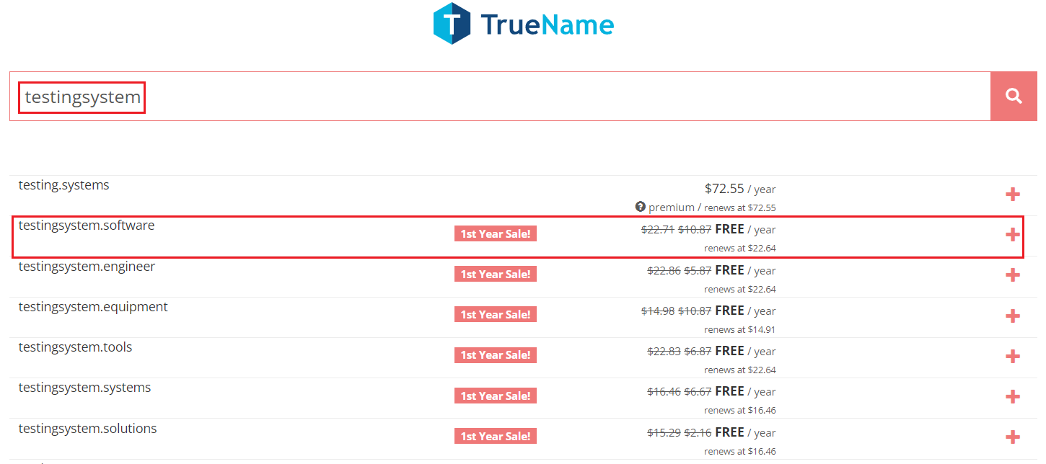
Route53 Service
Register free Domain
Register account & Add payment method
https://porkbun.com
Choose domain
https://porkbun.com/truename?coupon=LOWENDTALK

Slide 11
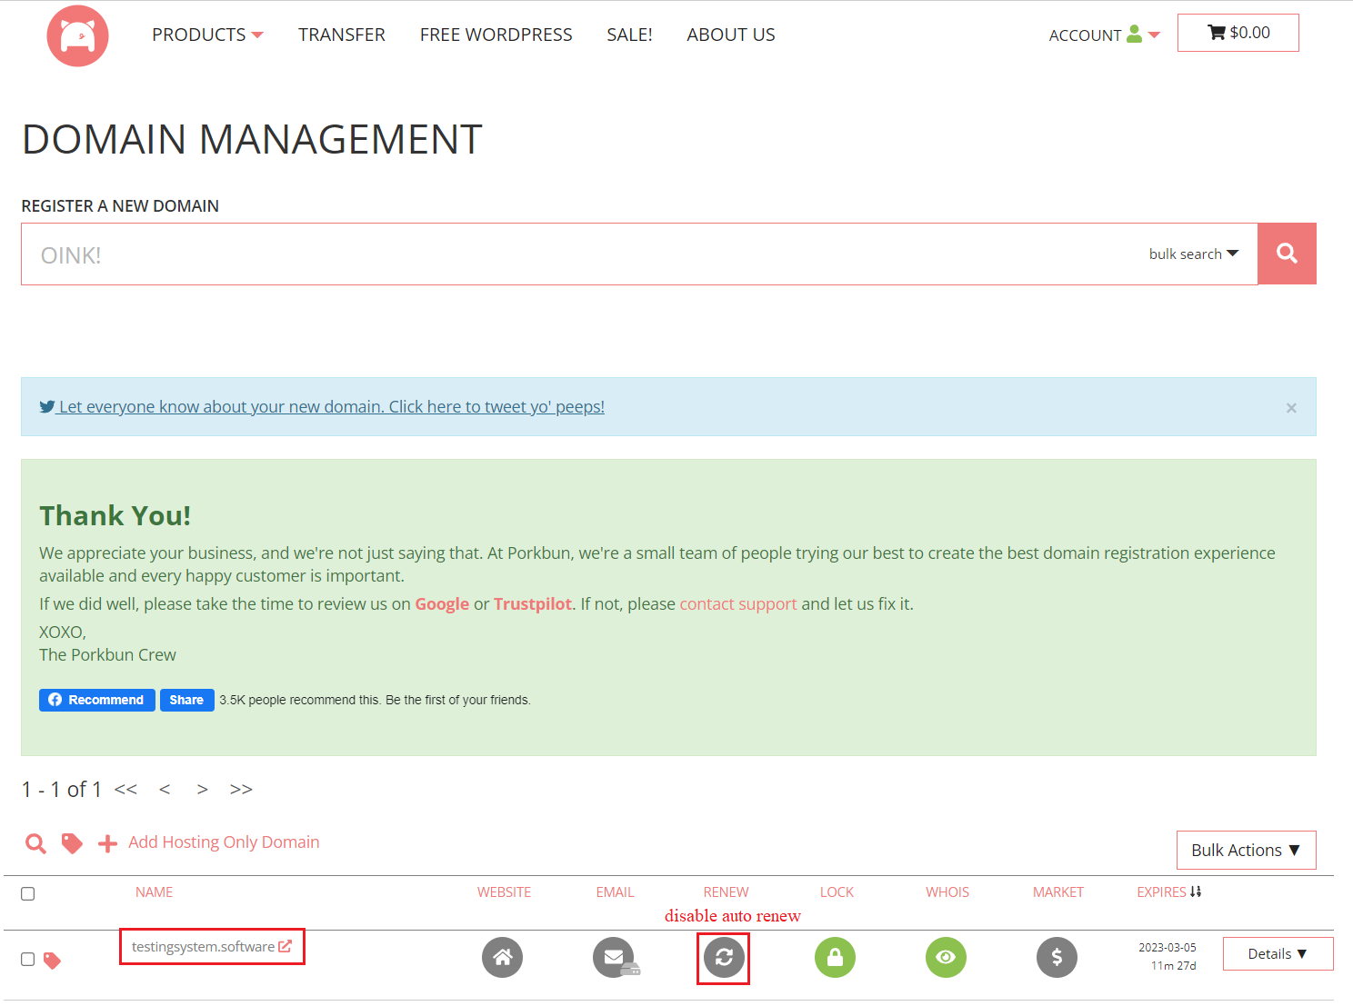
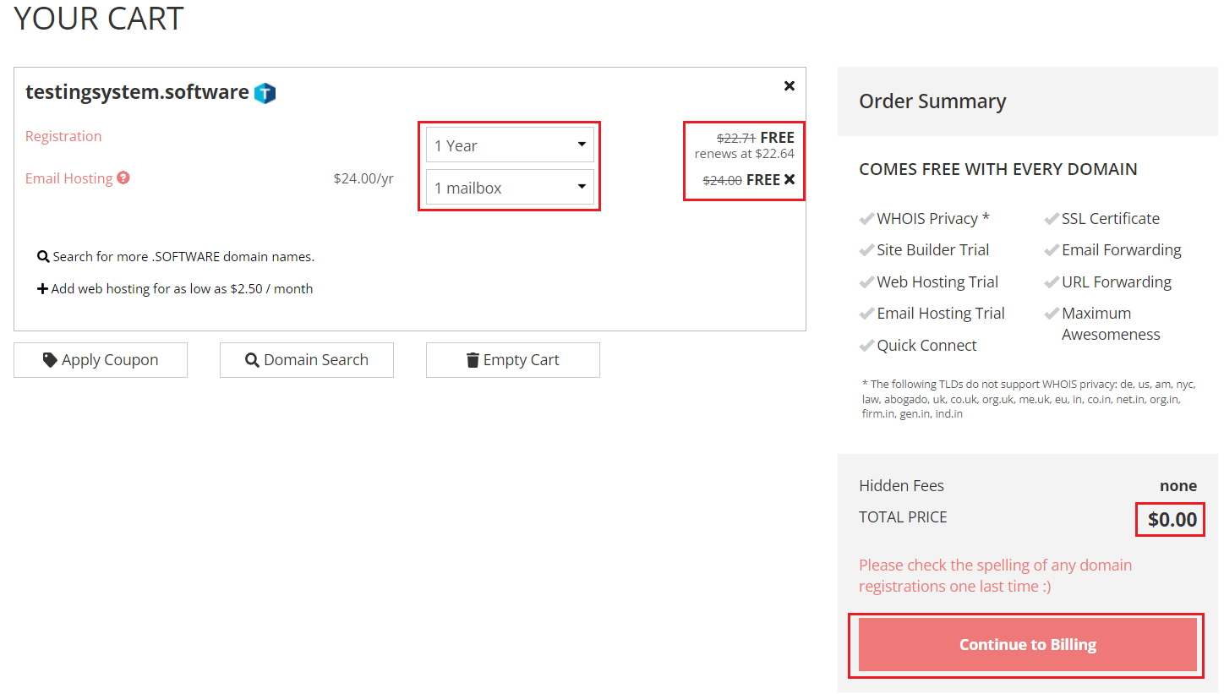
Route53 Service
Checkout
Domain Information

Slide 12
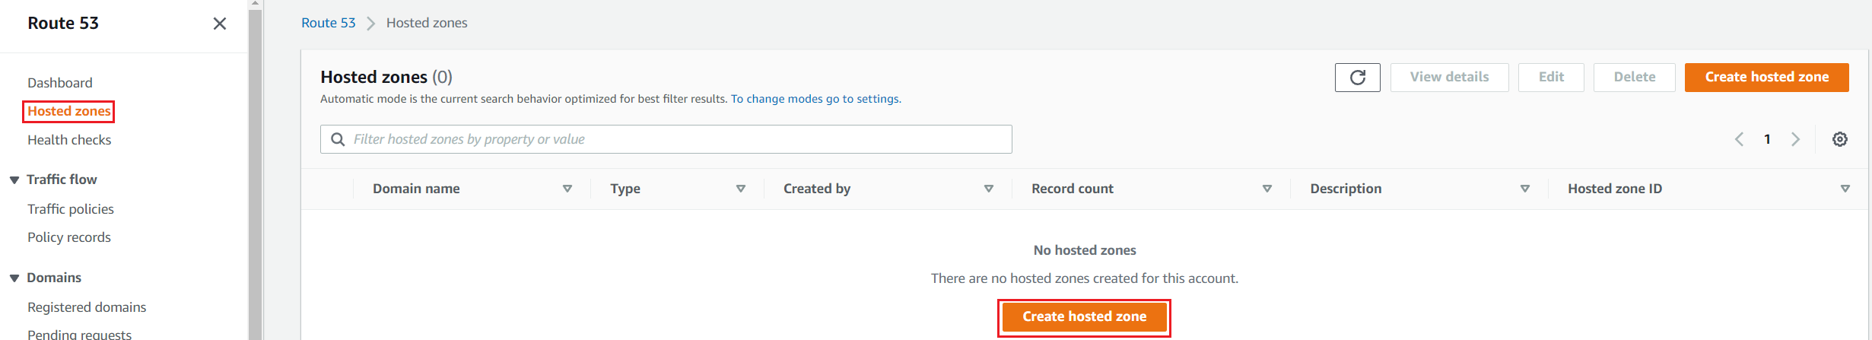
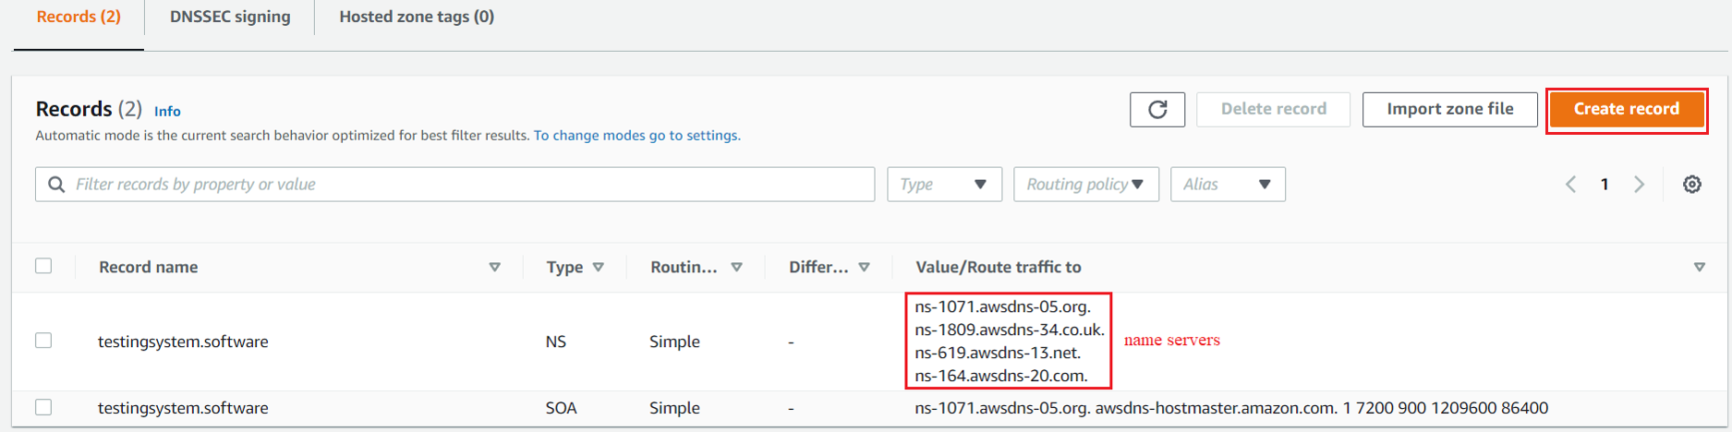
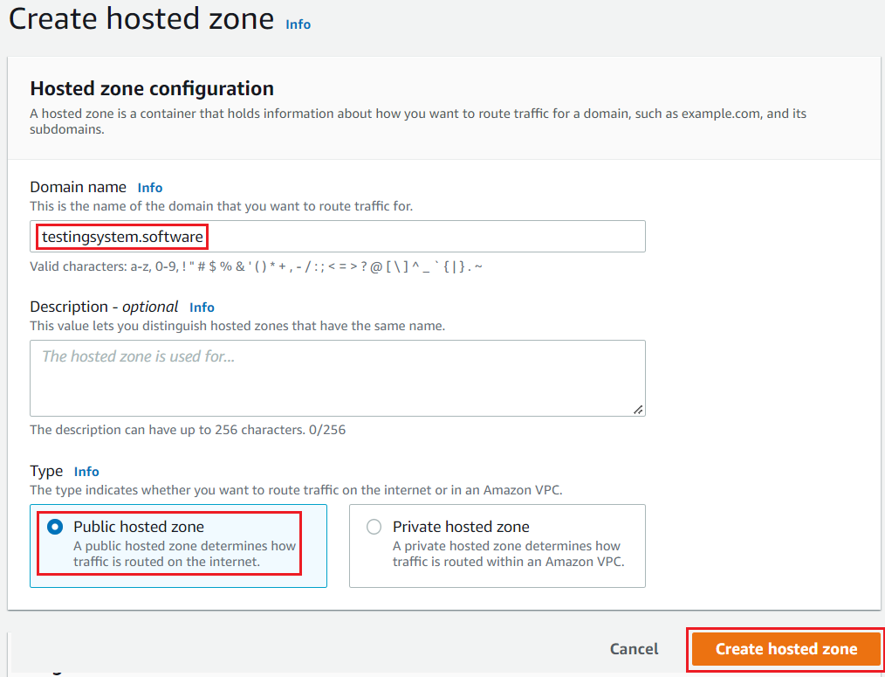
Route53 Service
Config Hosted Zone

Slide 13
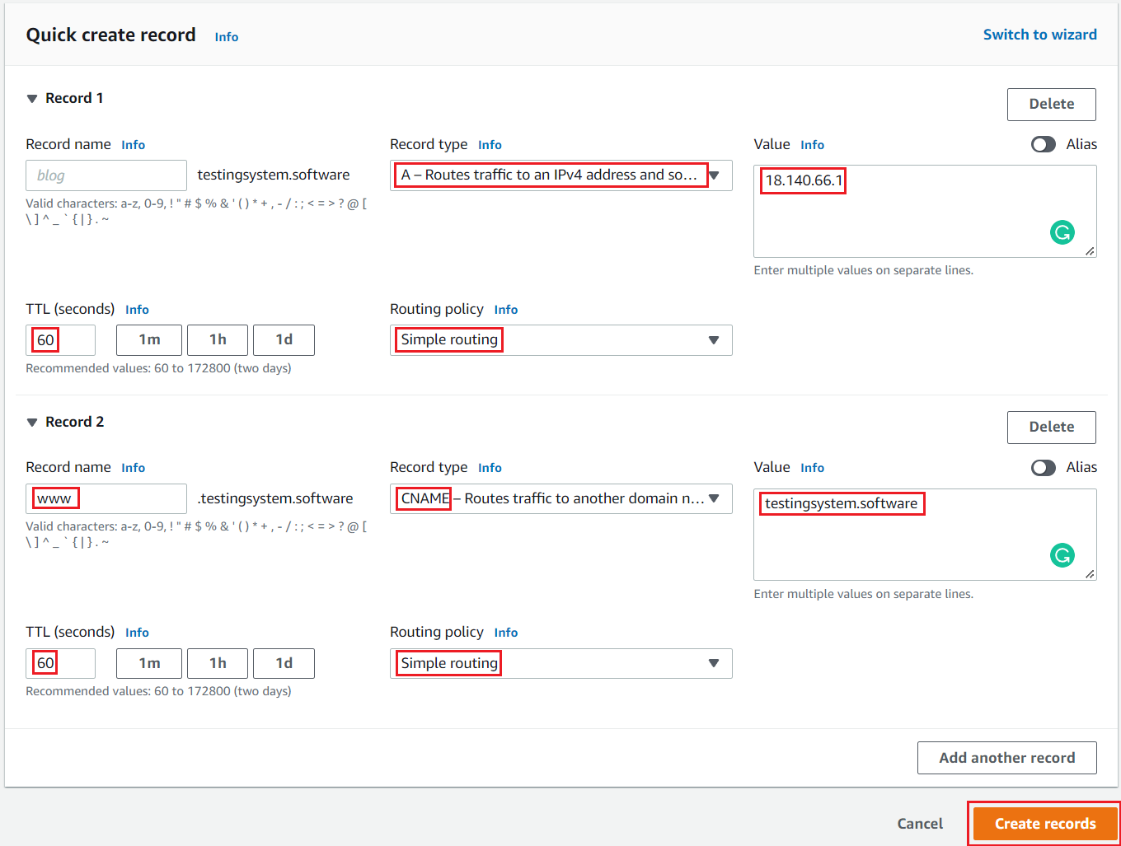
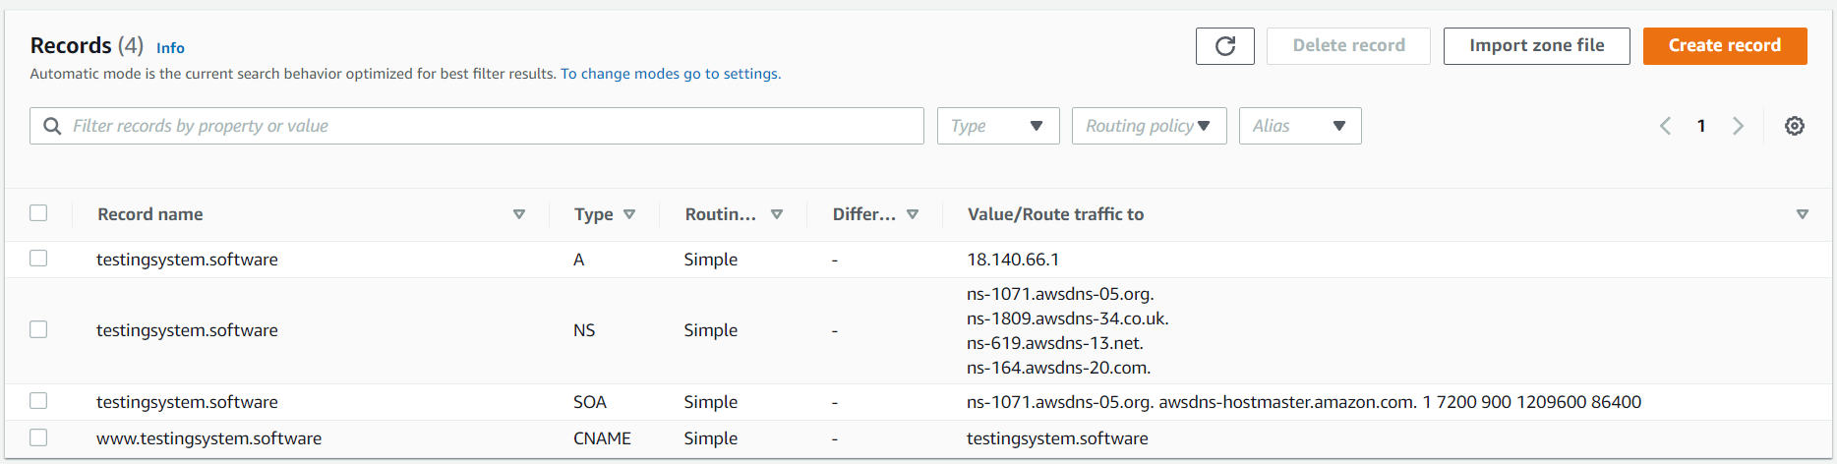
Route53 Service
Config Record

Slide 14
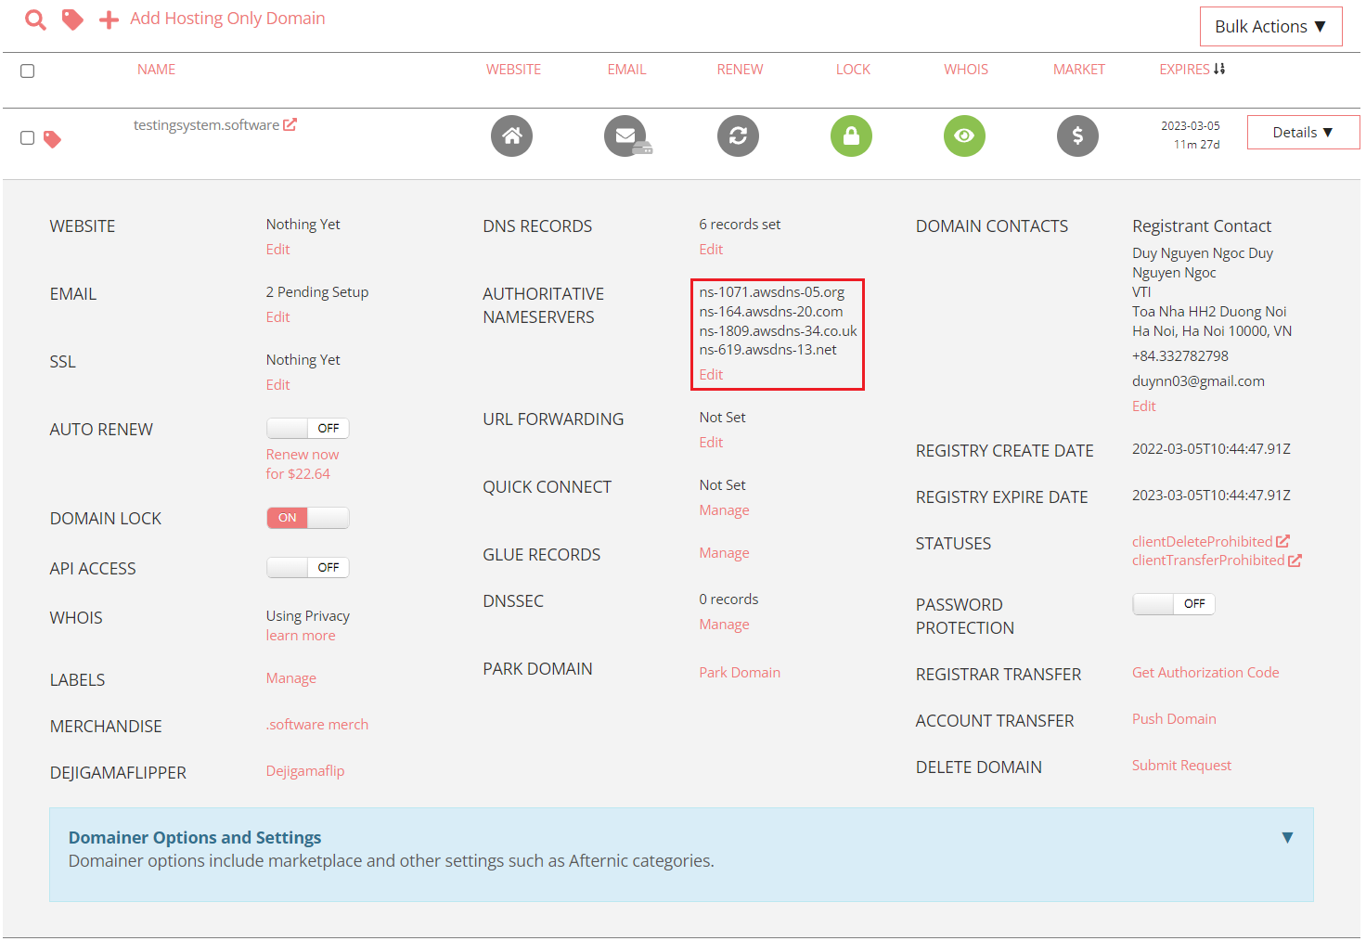
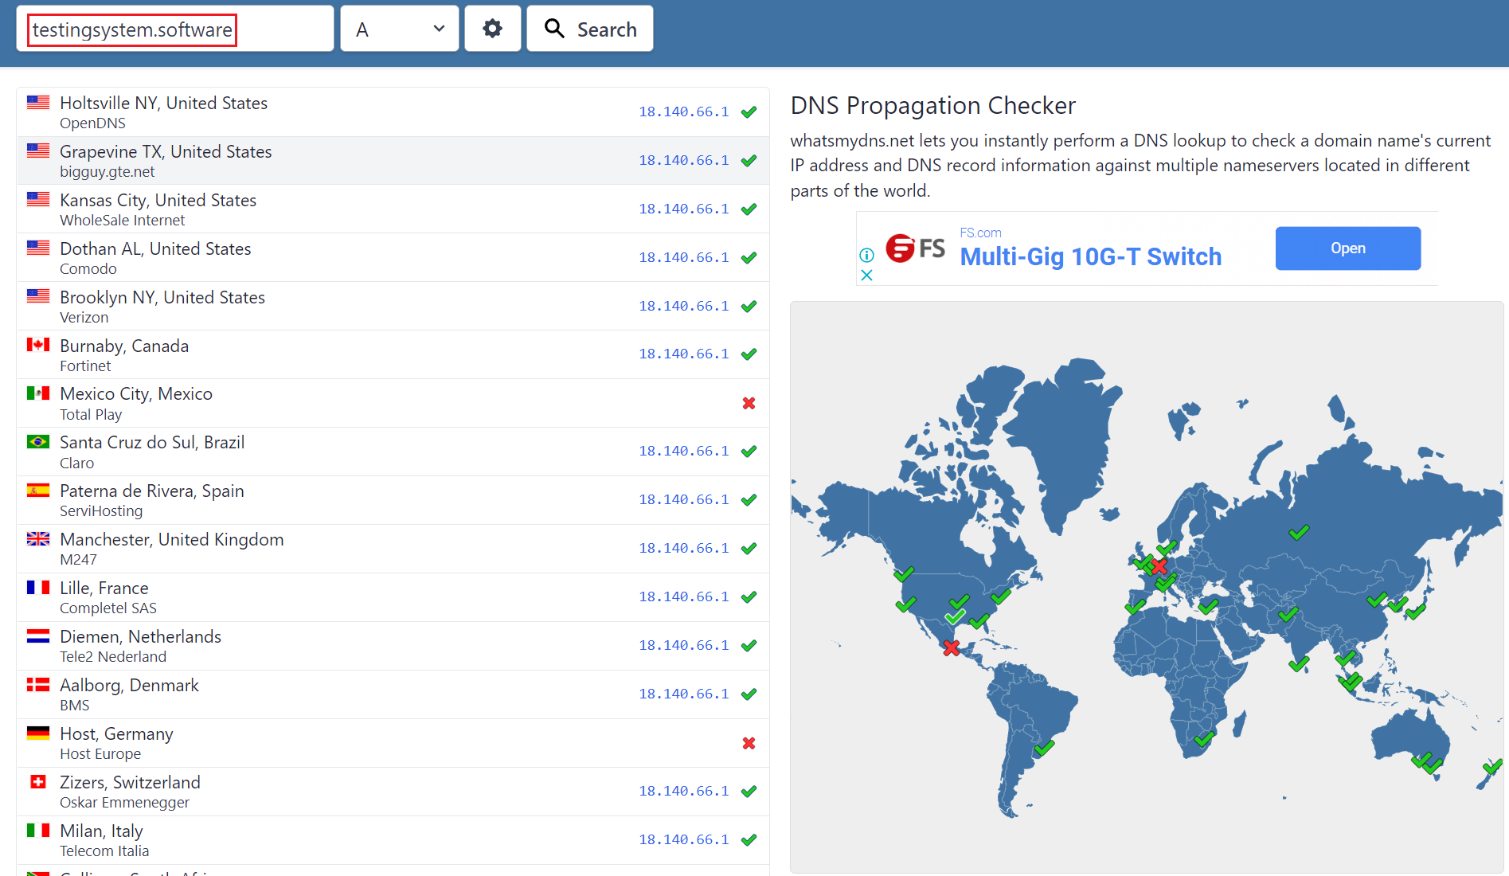
Route53 Service
Update NameServer for Domain
Waiting ~ 1 hour
Check DNS update
https://www.whatsmydns.net

Slide 15
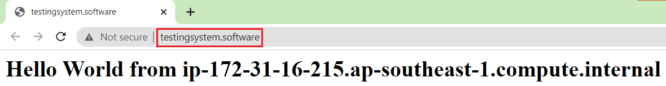
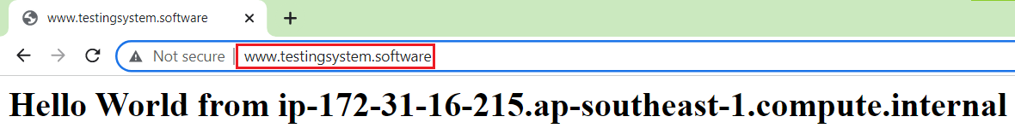
Route53 Service
Test
Tutorial: https://www.youtube.com/watch?v=igAdBIneaqE

Slide 16
Assignment
Self-practice

Slide 17
Route53 Service
Components
Domain
Name Server
Hosted zone
Record
Traffic flow

Slide 18
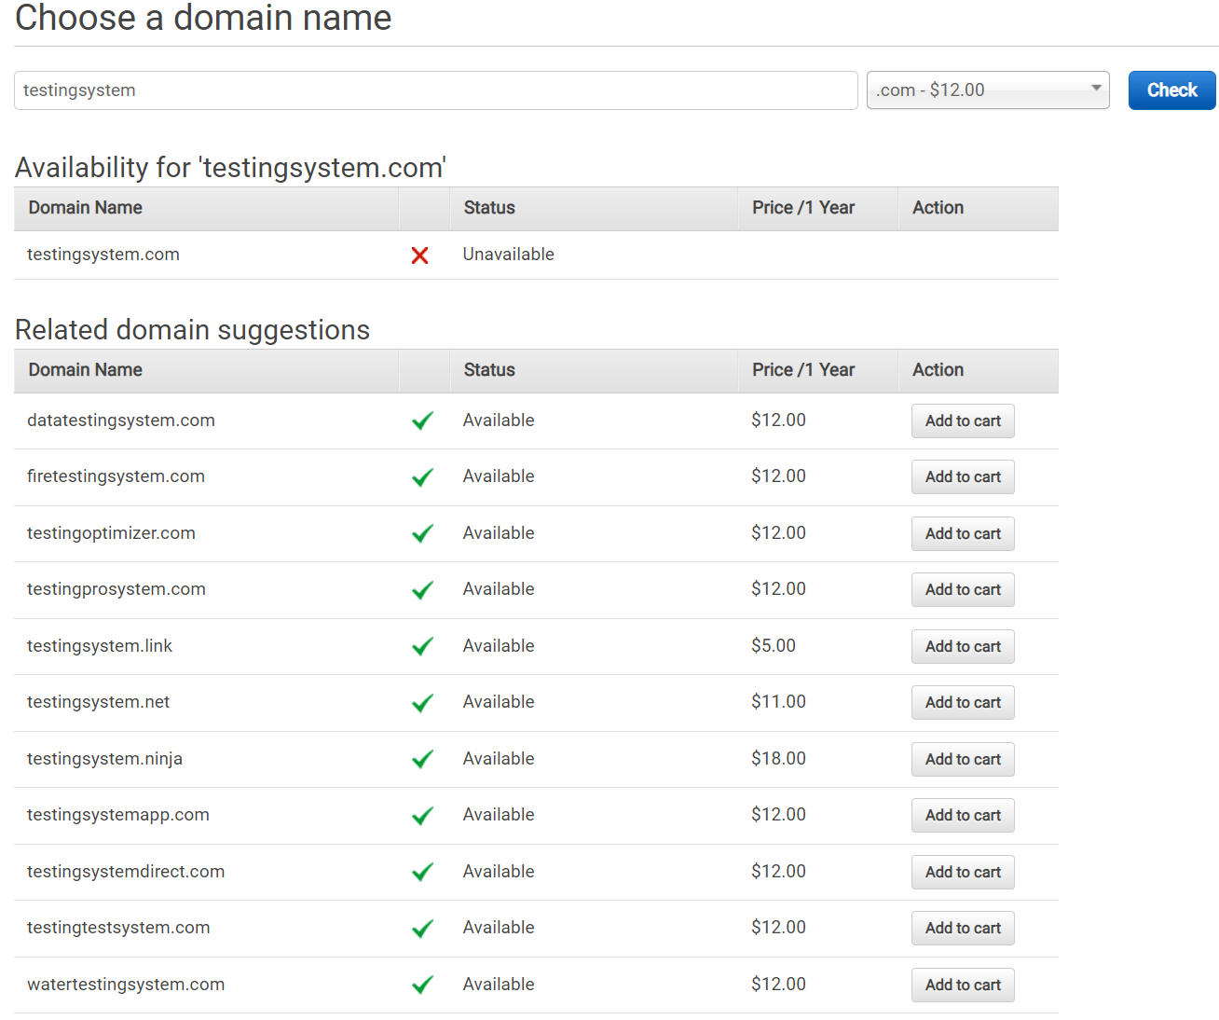
Route53 Service
Domain
Domain: example.com / Subdomain: acme.example.com, zenith.example.com
Domain provided by AWS or provided by a 3rd party (freenom , porkbun.com)
Features of the AWS domain provided
Non-changeable, non-refundable
Can transfer domain to another account
Top-level domains (TLDs): .com, .edu, .gov, .co.uk
Tutorial: https://www.youtube.com/watch?v=5IfDzpkLlYY

Slide 19
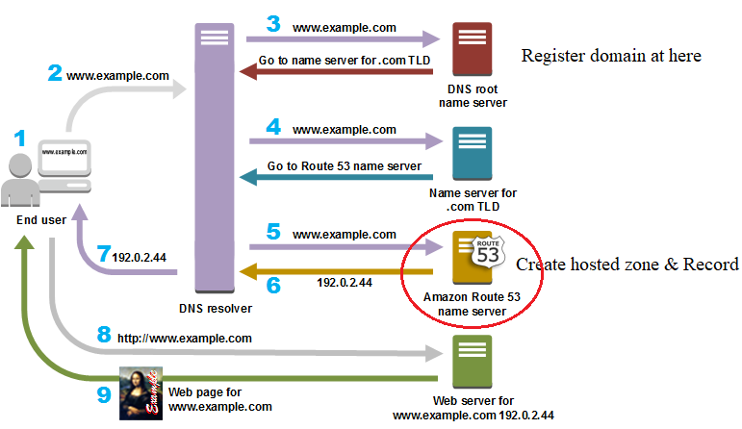
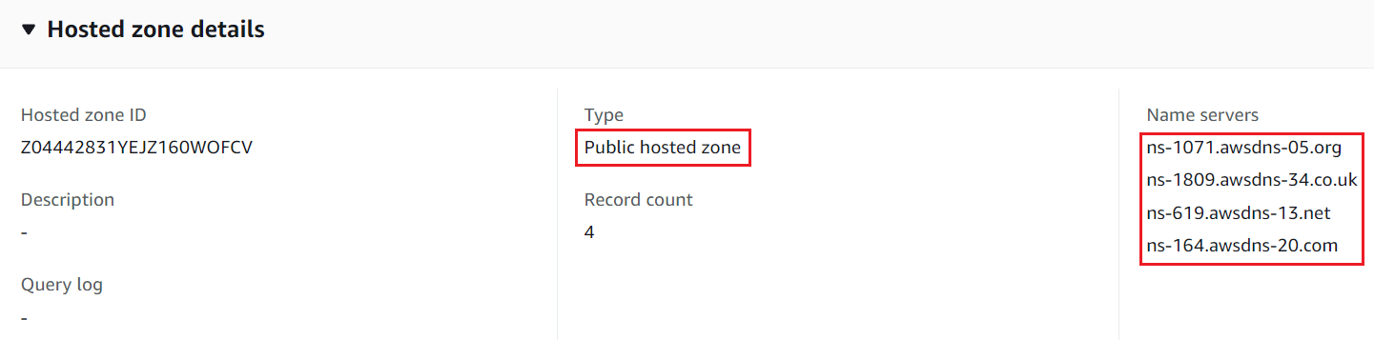
Route53 Service
Name Server (NS)
AWS provides 4 name servers
Must configure the name server on the domain registrar
Hosted Zone
Manage information & route traffic of domains & subdomains
Can configure multiple hosted zones for 1 domain

Slide 20
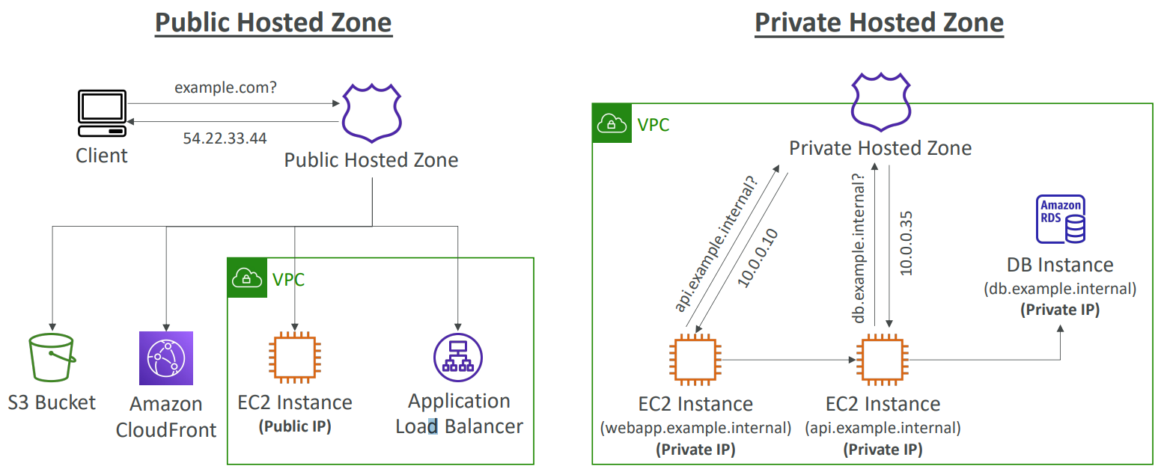
Route53 Service
2 types:
Public: resolve domain to public IP, public endpoint or AWS public resource
Private: resolve domain to private IP, private endpoint in VPC

Slide 21
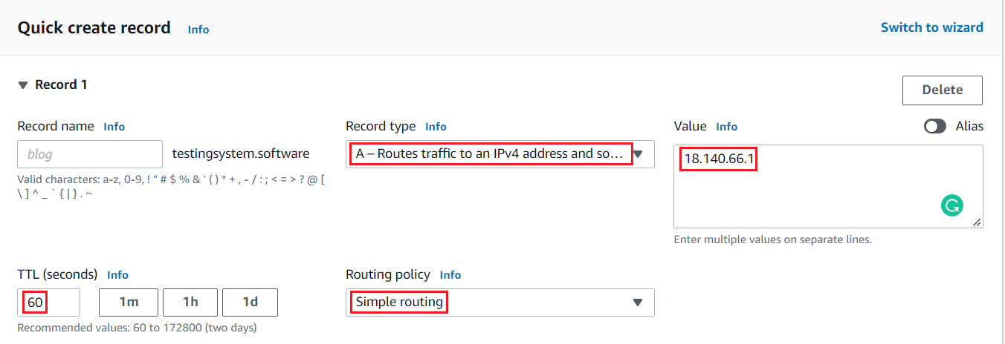
Route53 Service
Record
Config route traffic to domain/subdomain
Types
A (address): Mapping to Ipv4 or AWS resource
AAAA: Map to Ipv6 or AWS Resource
CName (Canonical name): Map to other domain (Subdomain)
MX: Map to mail server
…

Slide 22
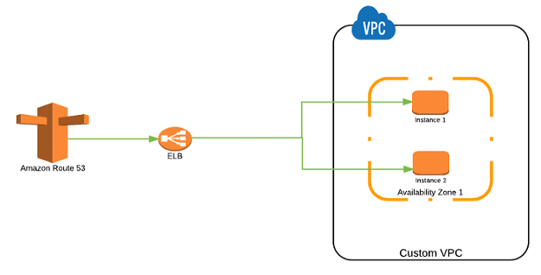
Route53 Service
Value
Ipv4, Ipv6
Other domain, subdomain
Endpoint: S3, VPC, Global Accelerator, Network load balancer, Cloudfont, API Gateway
Routing Policy
Simple Routing: Mapping a domain to a single resource
Ex: mapping domain to web service
Simple Routing

Slide 23
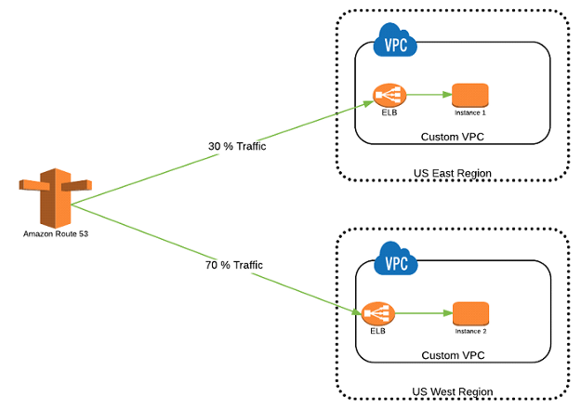
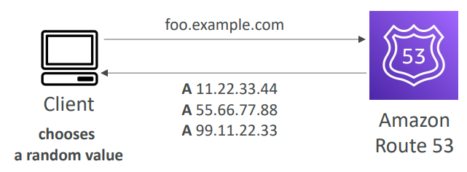
Route53 Service
Multi-value answers policy: Similar to Simple Routing but with additional health check
Weighted Routing: Map a domain to many resources according to traffic rate
Multivalue answers policy
Weighted Routing

Slide 24
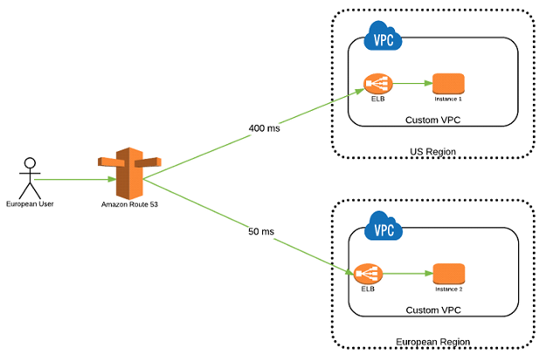
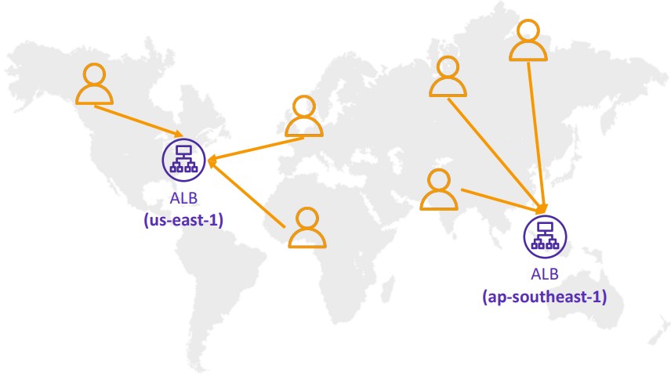
Route53 Service
Latency-based Routing: When there are resources located in many regions, routing will be performed to achieve the best latency
Latency-based Routing

Slide 25
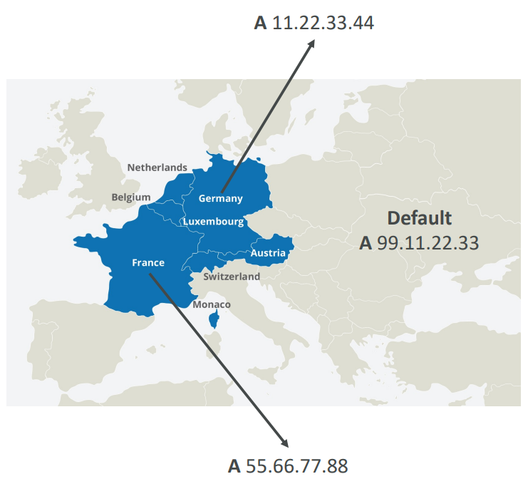
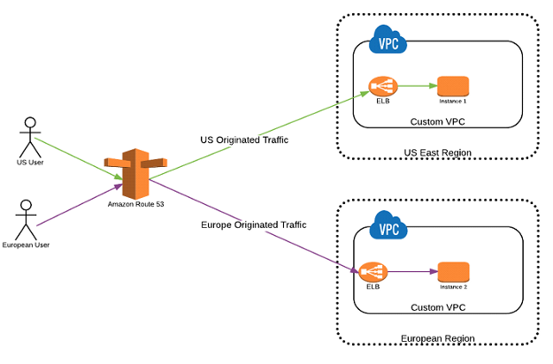
Route53 Service
Geolocation Policy: Routing by geographical location from request
Geolocation Policy

Slide 26
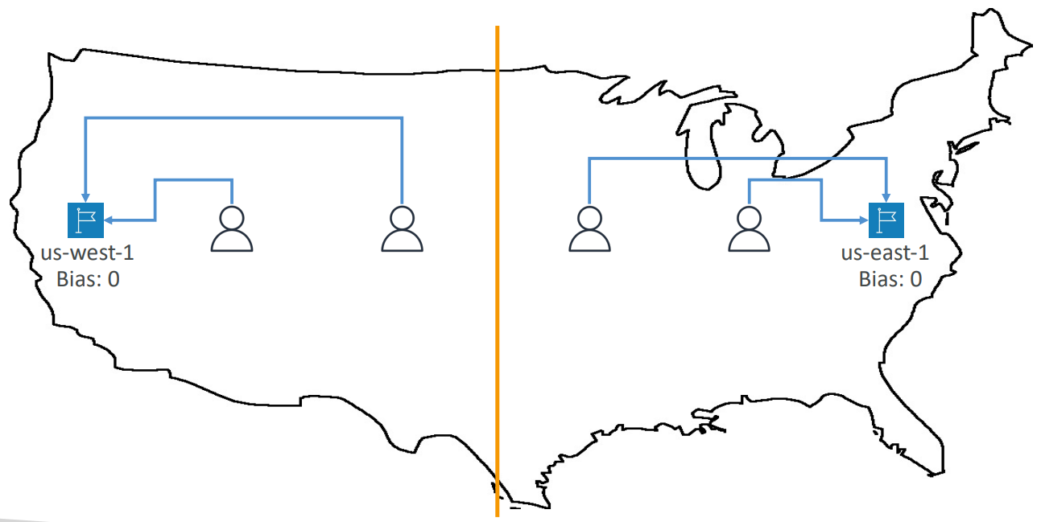
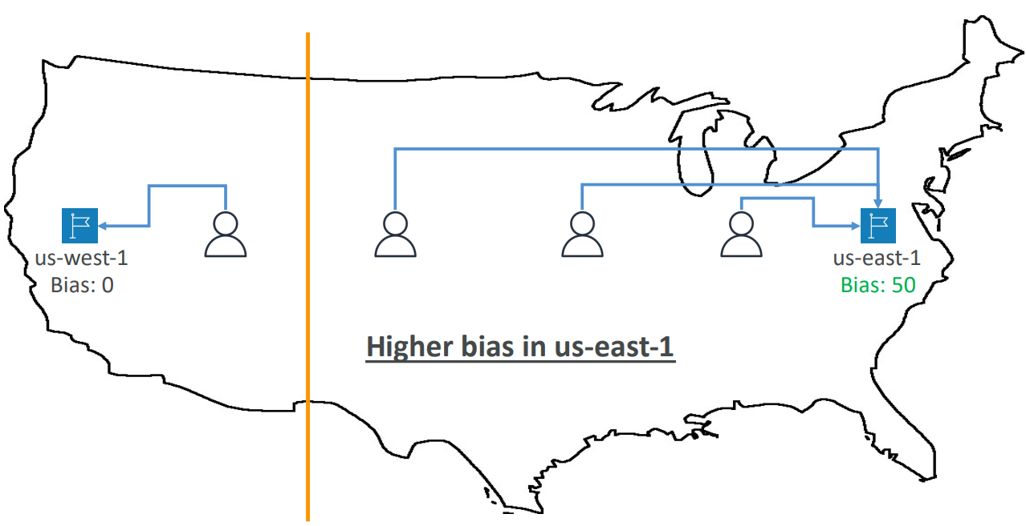
Route53 Service
Geoproximity routing policy: route traffic to your resources based on the geographic location of your users and your resources
Geoproximity routing policy

Slide 27
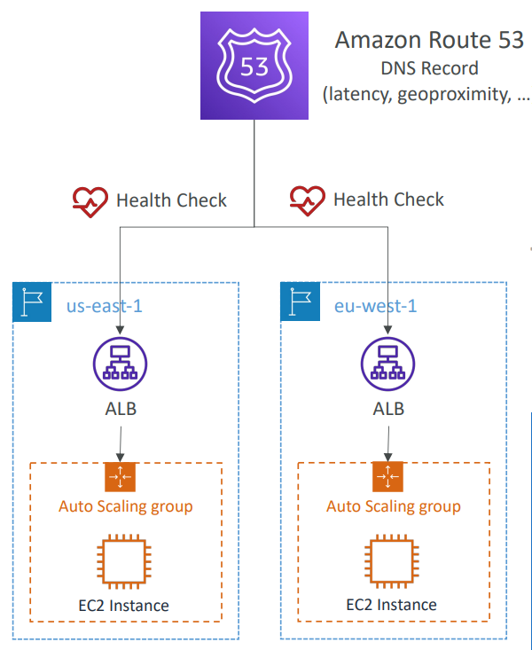
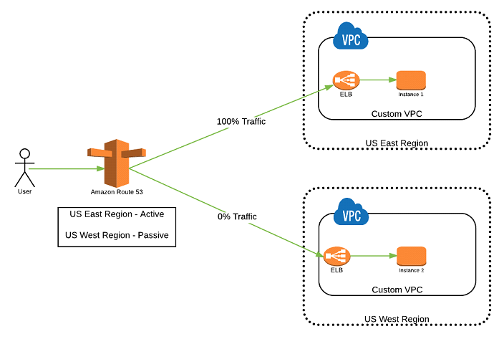
Route53 Service
Failover Routing
Config active & passive (primary & secondary), If the active is not working, it will automatically switch to passive
Support Health Check
Failover Routing

Slide 28
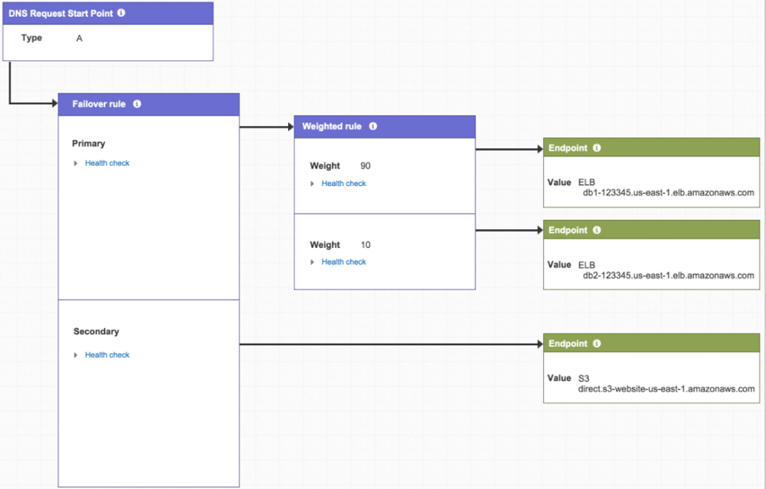
Route53 Service
Traffic flow
Manage & Visualize the relationship between multiple records
Tutorial: https://www.youtube.com/watch?v=PcoQY82SDHw

Slide 29
Summary
DNS resolves Domain to IP and IP to Domain
Route53 Service is a domain management service on AWS
You can map domain/subdomain to IP, Endpoint, Private AWS Resources in VPC
Record
Type: A, AAAA, CName, MX, Alias...
value: Ipv4, Ipv6, Endpoint
Routing Policy: Simple Routing, Multi-value answers policy, Weighted Routing, Latency-based Routing, Geolocation Policy, Geoproximity routing policy, Failover Routing

Slide 30
Summary
Features
Domain Registration
Domain Management
DNS routing
Traffic flow
Health checking

Slide 31
Q & A
Copyright © VTI Academy All Rights Reserved

